Slide 1
Project airport
Artem Bordetskiy
John Buckholt
Jacob Greenbaum
Ronald Rivas

Slide 2
What if…you knew how busy the airport will be before you arrive?
What times are the busiest at a specific airport?
What does this mean in terms of the the volume of passengers in said airport and furthermore, using this data, can we determine when the best time to arrive at the airport is?

Slide 3
What led us to chose this project?
John was a corporate pilot and through collaboration we came up with the idea of tracking the volume of flights in a particular airport.
Our first idea was to track a flight’s geolocation (we should have known better!!).
We weren’t sure whether this would be historical data, present data, or future data.
We realized the limitation that all data relating to aviation is not readily publicly available.
We are utilizing the current day’s data based on the API.

Slide 4
API
https://aviation-edge.com/
http://aviation-edge.com/developers/

Slide 5
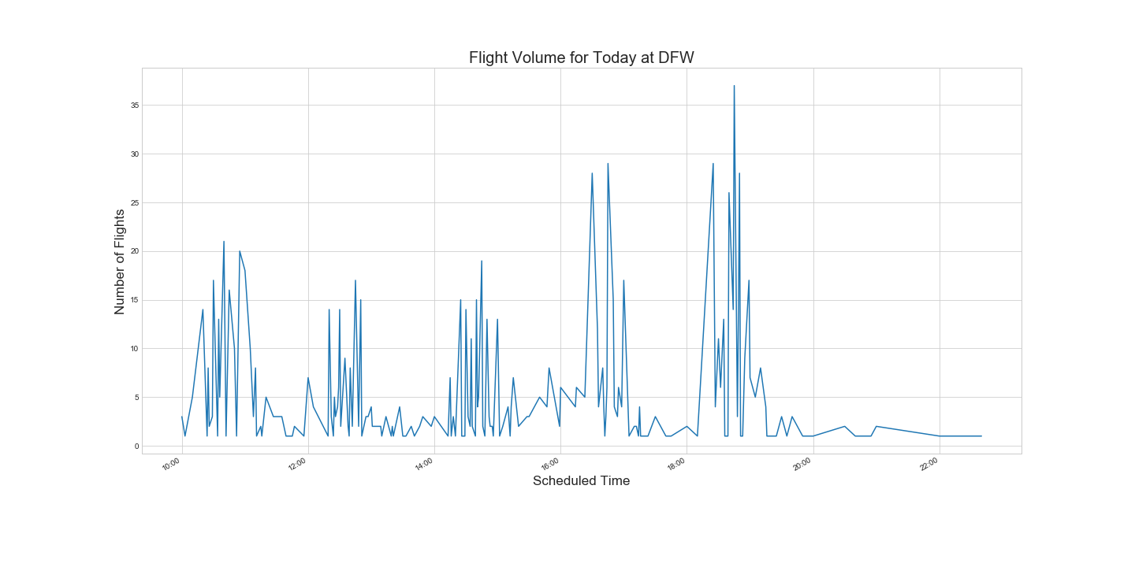
Flight Volume: Departing Airport

Slide 6
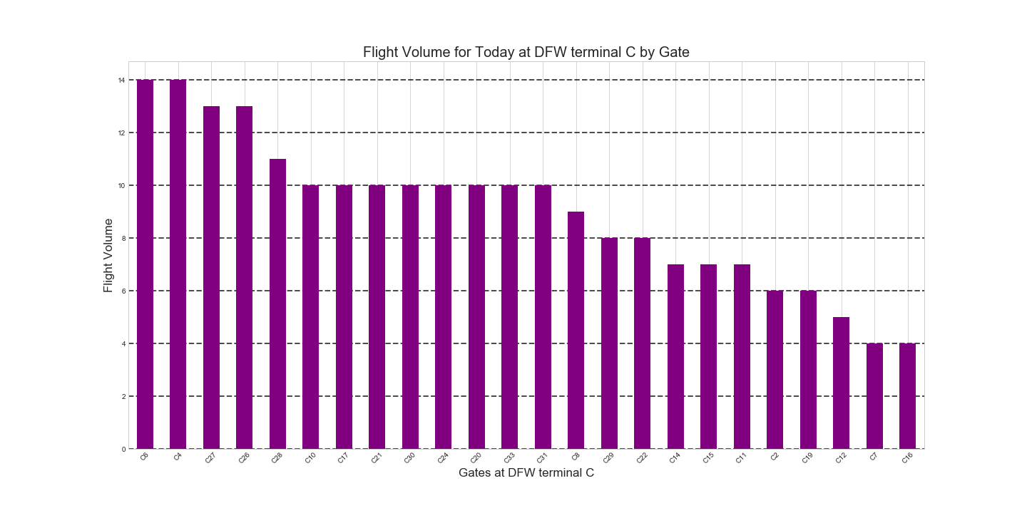
Flight Volume at a Specific Terminal: Departing Airport

Slide 7
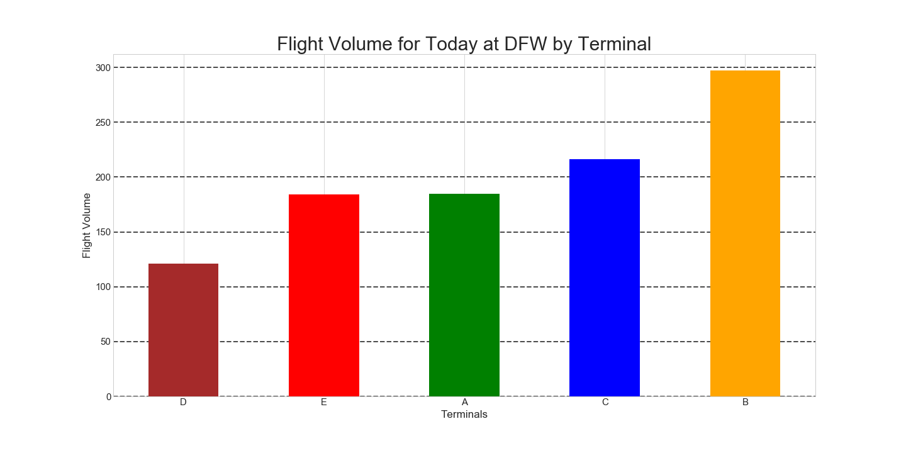
Flight Volume all Terminals: Departing airport

Slide 8
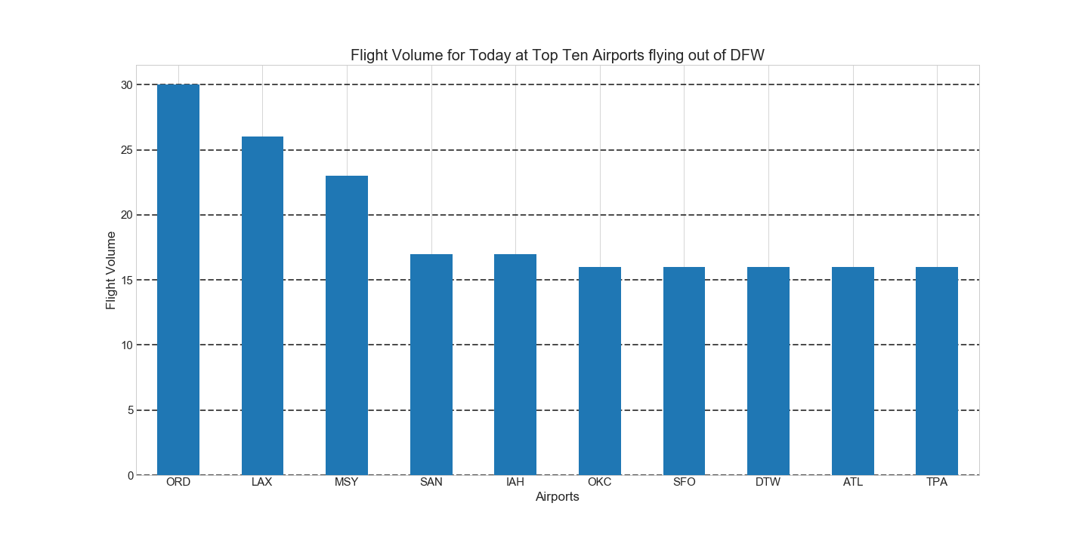
Flight Volume: departing airport

Slide 9
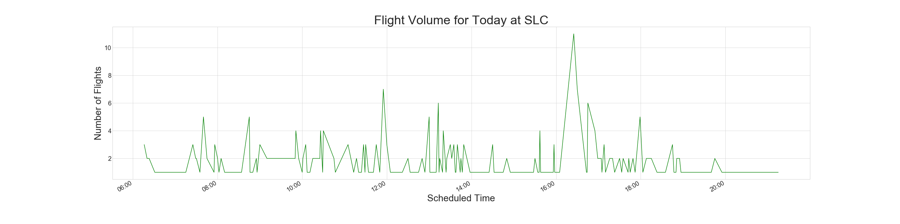
Flight Volume: Destination Airport

Slide 10
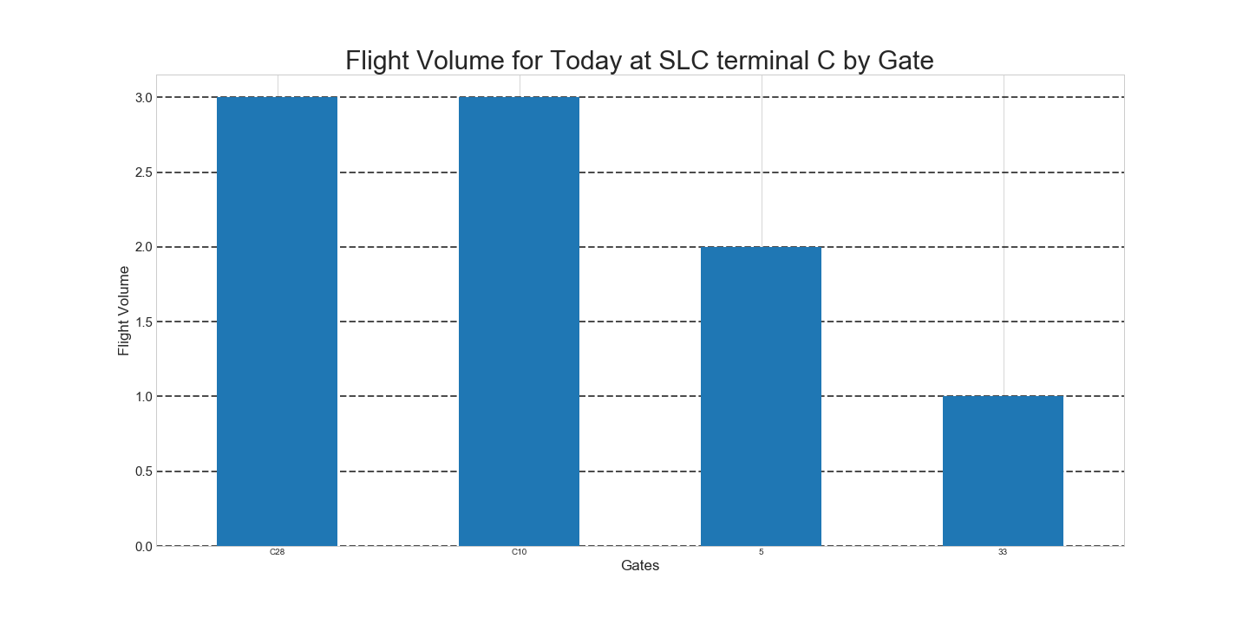
Flight Volume at a Specific Terminal: destination Airport

Slide 11
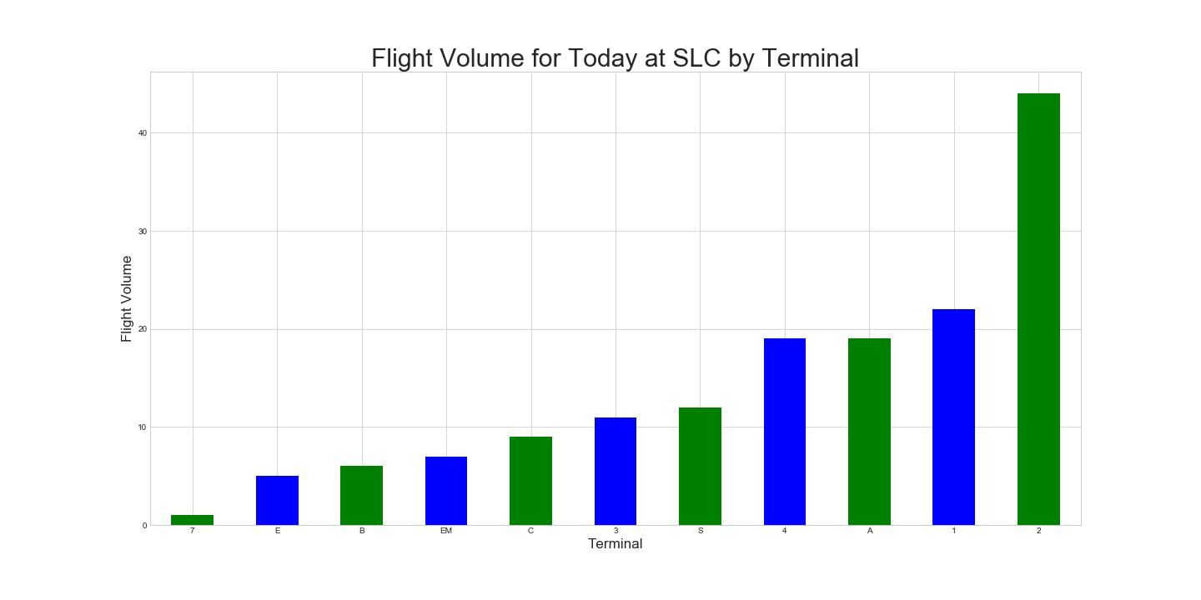
Flight Volume all Terminals: destination airport

Slide 12
Limitations
”Confounds” – variables that could be getting in the way of results
Transfers don’t come through security
At any given airport, especially a hub like DFW, a large portion of the passengers are there for connecting flights
Historical data is not readily available (limited to just today)
Don’t have passenger volume data
The wave effect or lull
Staffing

Slide 13
Conclusions

Slide 14
Live Run

